Slide 1
Intelligent Agents

Slide 2
Objectives
Define an Agent
Define an Intelligent Agent
Define a Rational Agent
Explain different types of environments
Explain different Agent Architectures

Slide 3
Index
Introduction to Agent
Agent and Environment
Sensors and effectors
Autonomy in Agents
Rationality
Nature of Environment
The structure of Agents
Intelligent Agent types
Table Driven Agent
Simple Reflex Agent
Model Based reflex Agent
Goal Based Agent
Utility Based Agent
Learning Agent
Scenario
References

Slide 4
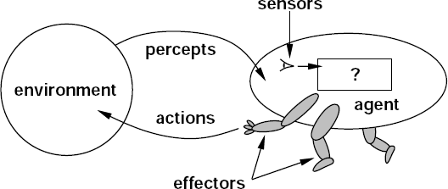
Introduction to Agent
An agent
is anything that can be viewed as perceiving its
environment through sensors and acting upon that environment through
actuators.
Operates in an environment
Perceive its environment through sensors
Acts upon its environment through actuators/ effectors
Has Goals

Slide 5
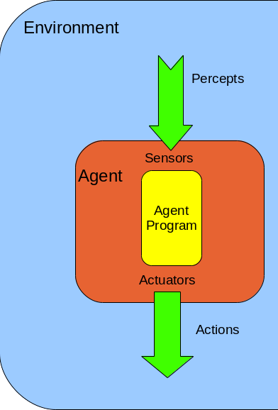
Agents and environment
An agent “perceives
its environment
through sensors and acts upon that environment through actuators.”
An agent's choice of action can depend on the
entire history
of percepts observed on anything it has not
previously, but not perceived.
Agents include Humans, Robotic and Software

Slide 6
Continue…
An Agent function can be seen as a mapping between percept sequences and actions.
Agent Function : Percept ∗ → Action ∗
The less an agents relies on its built-in knowledge, as opposed to the current percept sequence, the more autonomous it is.
The agent program runs on the physical architecture to produce function agent = architecture + program
A rational agent is an agent whose acts try to maximize some performance measure.

Slide 7
SENSOR AND EFFECTORS
An agent perceives its environment through sensors
The complete set of inputs at a given time is called a percept (or)
The term percept to refer to the agent’s perceptual inputs at any given instant
Percept sequence is the complete history of everything the agent has ever
perceived
The current percept or Sequence of percepts can influence the action of an agent
It can change the environment through actuators/ effectors
An operation involving an actuator is called an action
Action can be grouped into action sequences

Slide 8

Human Agent
Perception: Eyes, Ears, Nose, etc..
Actuators: Hands, Legs
Robotic Agents
Perception: Sensors
Actuators: Motors
Software Agents
Perceptions: Keystrokes, i/p
Actuators : Output (display)
Agent types

Slide 9








EXAMPLES OF AGENTS
Humans | Programs | Robots
senses | keyboard, mouse, dataset | cameras, pads
body parts | monitor, speakers, files | motors, limbs
INTELLIGENT AGENTS |AMAR JUKUNTLA
9

Slide 10
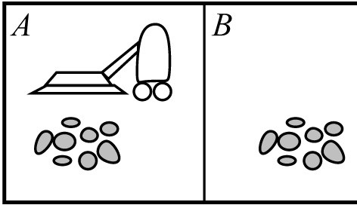
Example: Vacuum-Cleaner
Percepts: location and contents, e.g., [A,Dirty]
Actions: Left, Right, Suck, NoOp

Slide 11
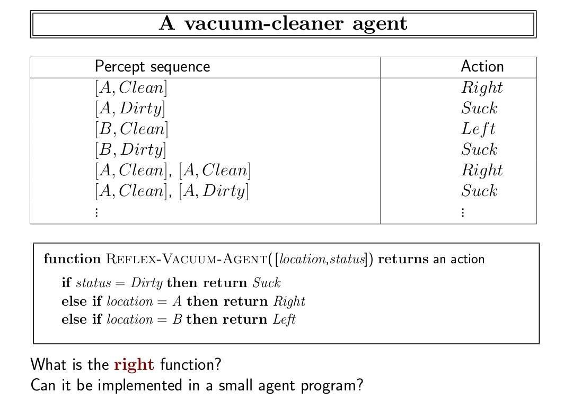

Slide 12

Autonomy in Agents
The autonomy of an agent is the extent to which its behavior is determined by its own experience (with ability to learn and adapt)
Extremes
No autonomy – ignores environment/data
Complete autonomy – must act randomly/no program
Example: baby learning to crawl
Ideal: design agents to have some autonomy
Possibly good to become more autonomous in time

Slide 13

Rationality
A rational agent is one that does the right thing.
Every entry in the table is filled out correctly.
What is the right thing?
Approximation: the most successful agent
Measure of success?
Performance measure should be objective
E.g. the amount of dirt cleaned within a certain time.
E.g. how clean the floor is.
Performance measure according to what is wanted in the
envIintreollignenmt Ageenntst|AimnarsJtuekuantdla
of how the agents should beh1a3 ve.

Slide 14

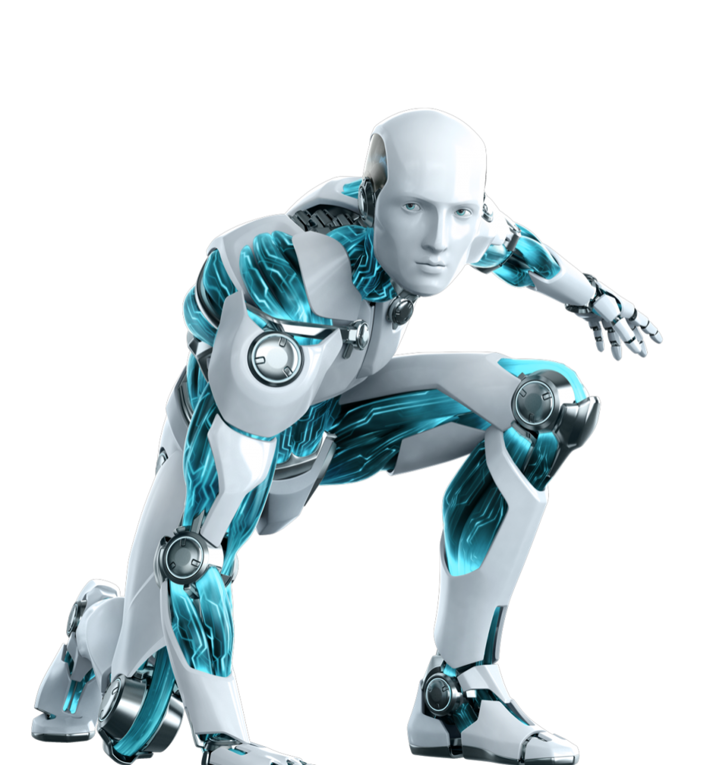
Continue…
What is rational at any given time depends on four things:
The performance measure that defines the criterion of success.
The agent's prior knowledge of the environment.
The actions that the agent can perform.
The agent's percept sequence to date.

Slide 15
Continue…
But, which action to choose? A rational agent is one that does the "right thing", which depends on the performance measure.
The performance measure should be designed to reflect what one actually wants in the environment, rather than how one suspects the agent should behave. Define it in terms of effects of actions on the environment, rather than in terms of the agent's program.
Rational behavior is not perfect, because an agent cannot know everything about the environment, including past, present, and future. We focus on maximizing expected performance, given what we know about probabilities of things happening in the environment.

Slide 16

Nature of Environments
Specify the task environment (PEAS):
P: performance measure
E: environment
A: agent's actuators
S: agent's sensors
Must first specify the setting for intelligent agent design
Consider, e.g., the task of designing an automated taxi driver:
–PEAS

Slide 17

Continue…
The task of designing an automated taxi driver:
Performance measure: Safe, fast, legal, comfortable trip, maximize profits
Environment: Roads, other traffic, pedestrians, customers
Actuators: Steering wheel, accelerator, brake, signal, horn
Sensors: Cameras, sonar, speedometer, GPS, odometer, engine sensors, keyboard

Slide 18
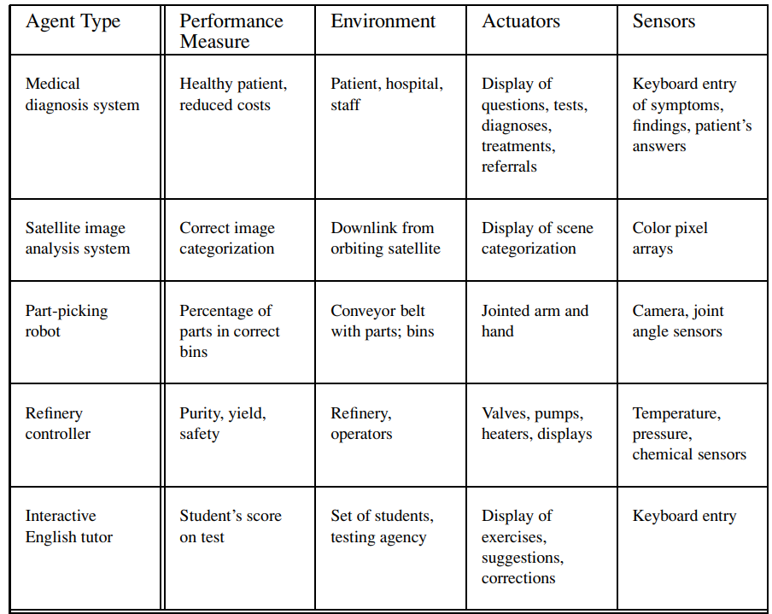
Examples of Agents

Slide 19
Environments –
Accessible vs. inaccessible
An accessible environment is one in which the agent can
obtain
complete, accurate, up-to-date information about the
environment’s state
Most moderately complex environments (for example, the everyday physical world and the Internet) are inaccessible.
The more accessible an environment is, the simpler it is to build agents to operate in it

Slide 20
Environments –
Deterministic vs. non-deterministic
A deterministic environment is one in which the next state of the environment is completely determined by the current state and the action executed by the agent.
The physical world can to all intents and purposes be regarded as non- deterministic.
Non-deterministic environments present greater problems for the agent designer.

Slide 21
Environments –
Episodic vs. non-episodic
In an episodic environment, the performance of an agent is dependent on a number of discrete episodes, with no link between the performance of an agent in different scenarios
Episodic environments are simpler from the agent developer’s perspective because the agent can decide what action to perform based only on the current episode — it need not reason about the interactions between this and future episodes

Slide 22
Environments–
Static vs. dynamic
A static environment is unchanged while an agent is reflecting.
A dynamic environment is one that has other processes operating on it, and which hence changes in ways beyond the agent’s control
Other processes can interfere with the agent’s actions (as in concurrent systems theory)
The physical world is a highly dynamic environment

Slide 23

Environments –
Discrete vs. continuous
An environment is discrete if there are a fixed, finite number of actions and percepts in it
Ex: chess game
Continuous environments have a certain level of mismatch with computer systems
Ex: taxi driving
Discrete environments could in principle be handled by a kind of “lookup table”

Slide 24
Different Terminology for kind of environment
Fully observable vs. partially observable, unobservable
Single agent vs. multiagent
Deterministic vs. stochastic
Episodic vs. sequential
Static vs. dynamic, semi-dynamic
Discrete vs. continuous
Known vs. unknown

Slide 25
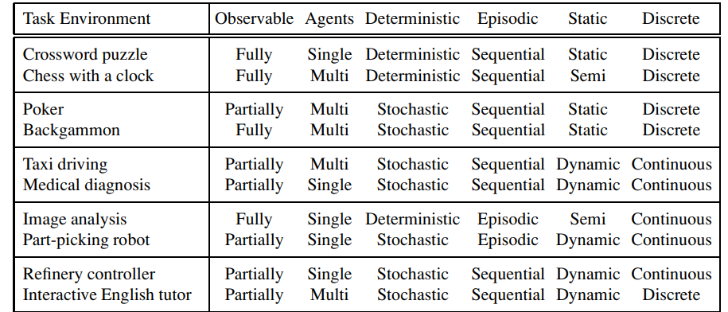

Slide 26
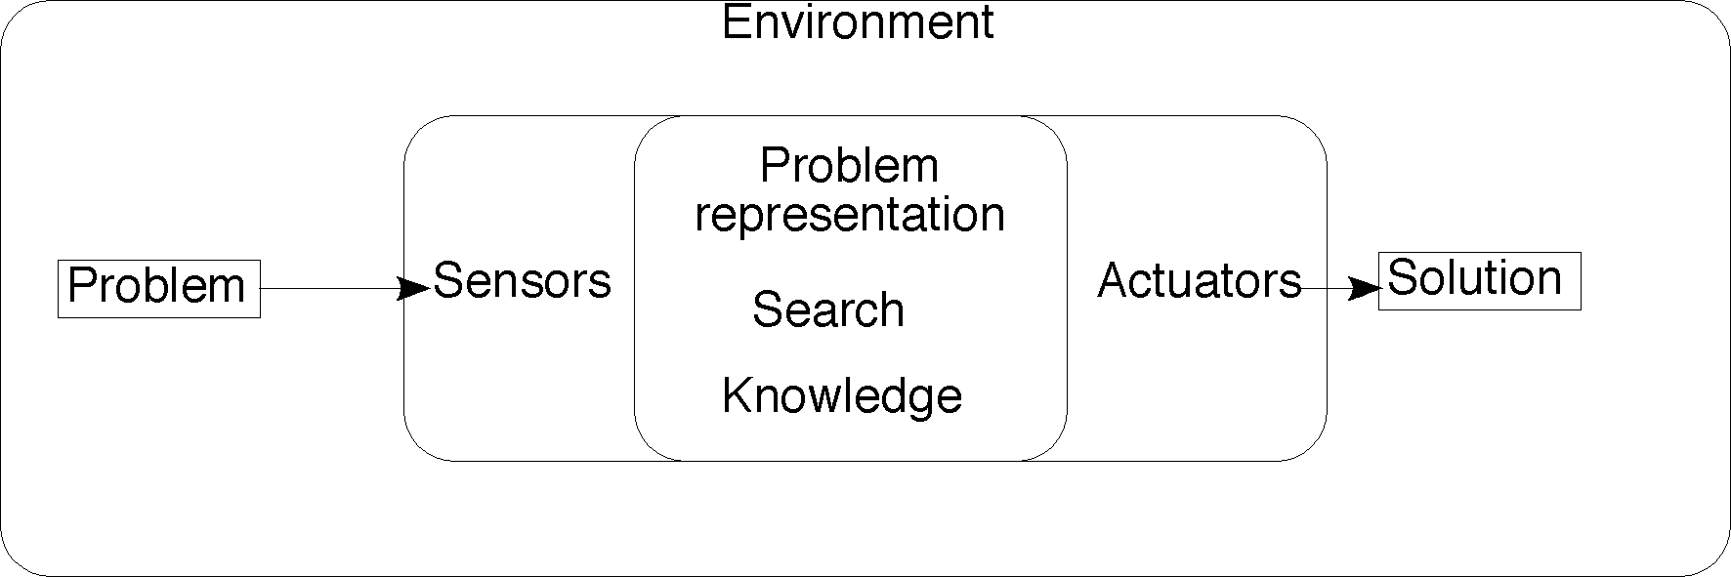
The job of AI is to design an agent program that implements the agent function, the mapping from percepts to actions.
We assume this program will run on some sort of computing device with physical sensors and actuators—we call this the architecture:
agent = architecture + program
In general, the architecture makes the percepts from the sensors available to the program, runs the program, and feeds the program’s action choices to the actuators as they are generated.
THE STRUCTURE OF AGENTS

Slide 27
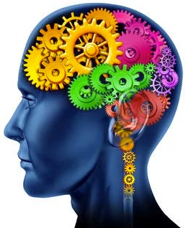
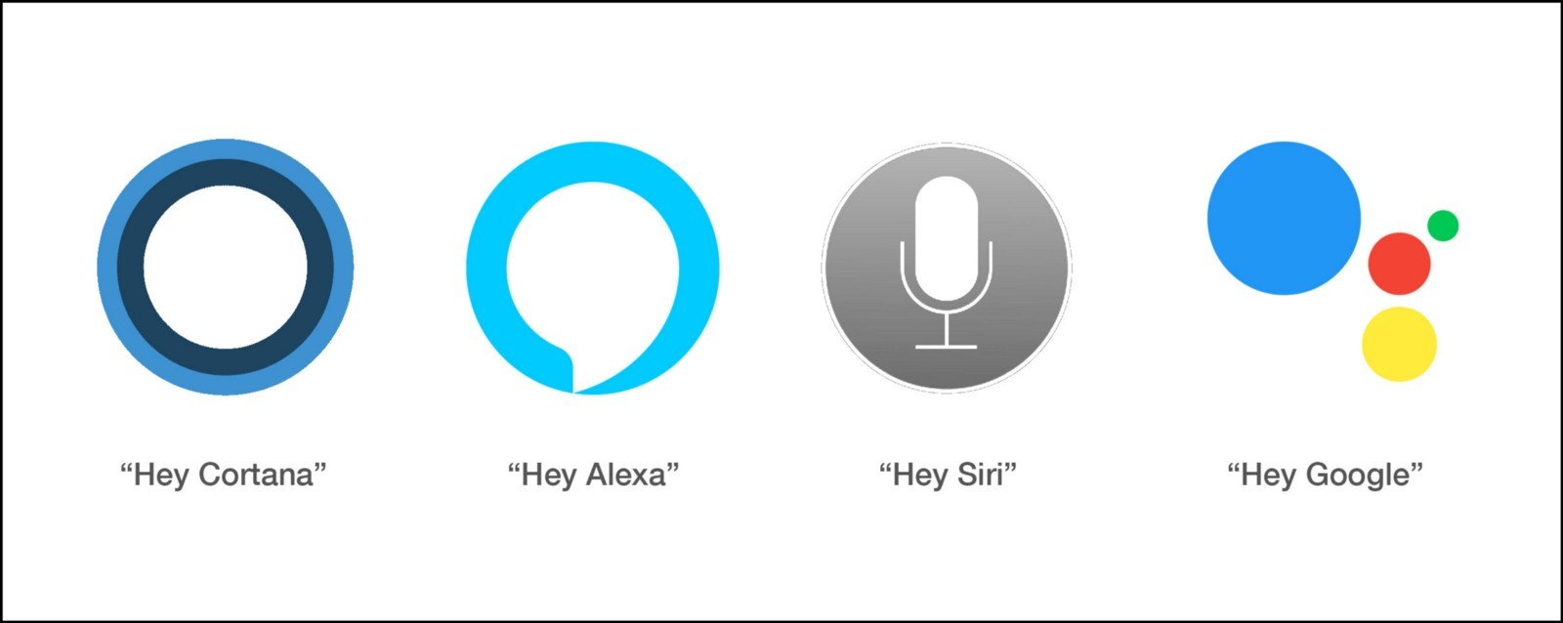
Intelligent Agents
Must sense
Must act
Must autonomous (to some extend)
Must rational

Slide 28


Agent types
Agents categories
Table Driven Agent
Simple Reflex Agent
Model based Agent
Goal based Agent
Utility based Agent
Learning Agent

Slide 29

Table Driven Agent
Agents have same skeleton: accepting percepts from an environment and generating actions. Each uses some internal data structures that are updated as new percepts arrive.
These data structures are operated on by the agent's decision-making procedures to generate an action choice, which is then passed to the architecture to be executed.
lookup table to
Table driven agents use a associate perceptions from pInotelslisgeinbt Algeentas |cAmtiaor Jnuksun.tla
the environment with
27

Slide 30
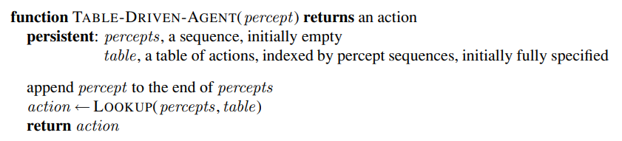
The TABLE-DRIVEN-AGENT program is invoked for each new percept and returns an action each time. It retains the complete percept sequence in memory

Slide 31
Continue…
There are several drawbacks in this technique:
Need to keep in memory entire percept sequence
Long time to build the table
Agent has no autonomy
Other alternatives to map percepts to actions are:
Simple Reflex agents
Agents that keep track of world
Goal-based agents
Utility-based agents

Slide 32
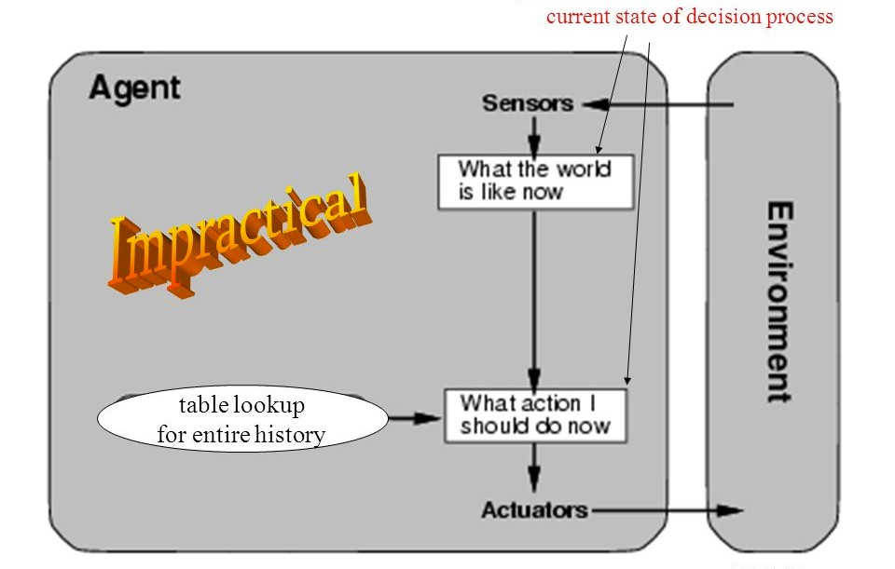

Slide 33
Simple Reflex Agent
Simple reflex agents ignore the rest of the percept history and act only on the basis of the current percept.
Percept history is the history of all that an agent has perceived till date. The agent function is based on the condition-action rule.
A condition-action rule is a rule that maps a state i.e, condition to an action. If the condition is true, then the action is taken, else not.
This agent function only succeeds when the environment is fully observable. For simple reflex agents operating in partially observable environments, infinite loops are often unavoidable.

Slide 34
Continue…
It may be possible to escape from infinite loops if the agent can randomize its actions. Problems with Simple reflex agents are :
Very limited intelligence.
No knowledge of non-perceptual parts of state.
Usually too big to generate and store.
If there occurs any change in the environment, then the collection of rules need to be updated.

Slide 35
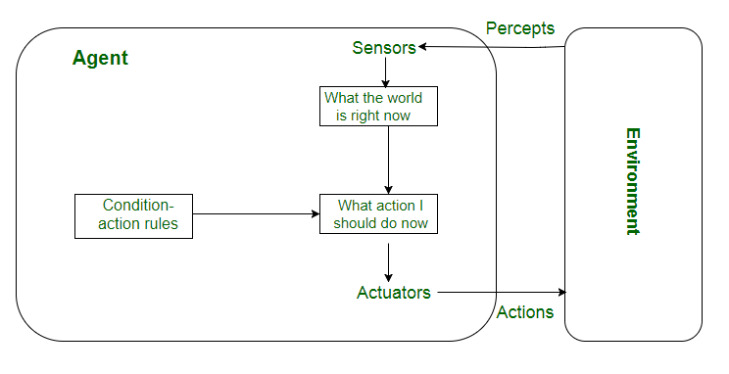

Slide 36
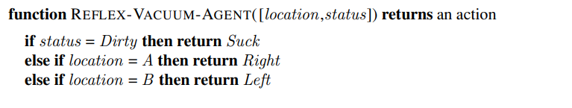
The agent program for a simple reflex agent in the two-state vacuum environment

Slide 37
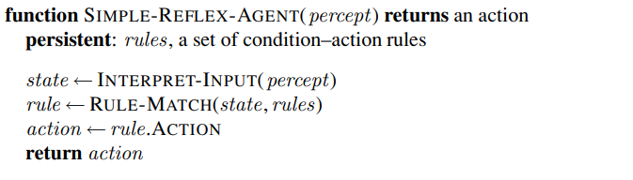
A simple reflex agent. It acts according to a rule whose condition matches the current state, as defined by the percept

Slide 38
Model Based reflex Agent
The most effective way to handle partial observability is for the agent to keep track of the part of the world it can’t see now.
Agent should maintain some sort of internal state that depends on the percept history and thereby reflects at least some of the unobserved aspects of the current state.
The agent has to keep track of internal state which is adjusted by each
percept and that depends on the percept history.

Slide 39
Continue…
The current state is stored inside the agent which maintains some kind of structure describing the part of the world which cannot be seen.
Updating the state requires the information about
How the world evolves independently from the agent
How the agent’s own actions affect the world
This knowledge about “how the world works”—whether implemented in
simple Boolean circuits or in complete scientific theories—is
called a model of the world.

Slide 40
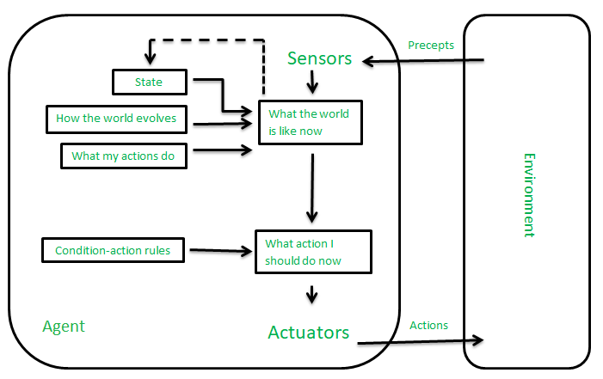

Slide 41
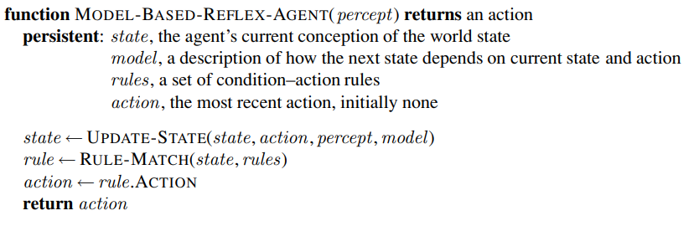
A model-based reflex agent. It keeps track of the current state of the world, using an internal model. It then chooses an action in the same way as the reflex agent

Slide 42
Goal Based Agent
Knowing something about the current state of the environment is not always enough to decide what to do.
For example, at a road junction, the taxi can turn left, turn right, or go straight on. The correct decision depends on where the taxi is trying to get to.
In other words, as well as a current state description, the agent needs some sort of goal information that describes situations that are desirable.

Slide 43
Continue…
The agent program can combine this with the model to choose actions that achieve the goal.
The knowledge that supports its decisions is represented explicitly and can be modified, which makes these agents more flexible.
They usually require search and planning. The goal based agent’s behavior can easily be changed.

Slide 44
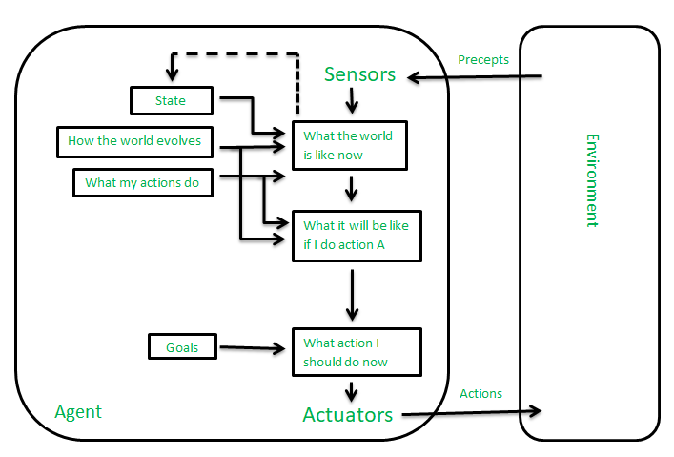

Slide 45
Utility Based Agent
Goals alone are not enough to generate high-quality behavior in most environments.
For example, many action sequences will get the taxi to its destination (thereby achieving the goal) but some are quicker, safer, more reliable, or cheaper than others.
Goals just provide a crude binary distinction between “happy” and “unhappy” states.

Slide 46
Continue…
Goals are not enough – need to know value of goal
Is this a minor accomplishment, or a major one?
Affects decision making – will take greater risks for more major goals
Utility: numerical measurement of importance of a goal
A utility-based agent will attempt to make the appropriate tradeoff
Different preferences for different goals.
A utility function maps a state or a sequence of states to a real valued utility.
The agent acts so as to maximize expected utility.

Slide 47
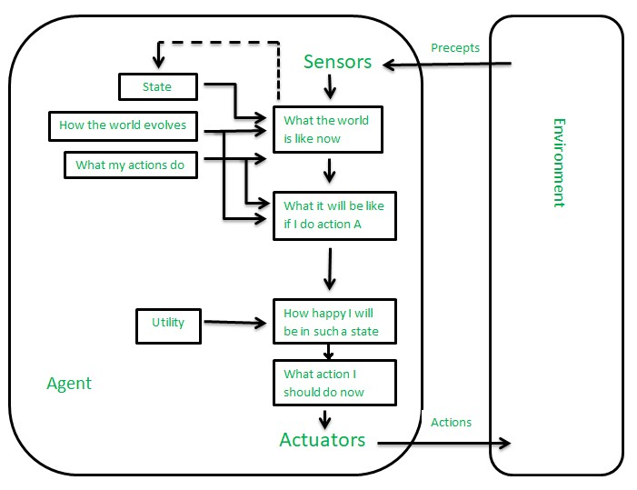

Slide 48
Learning Agent
Learning allows an agent to operate in initially unknown environments.
Learning is required for true autonomy.
A learning agent can be divided into four conceptual components.
The most important distinction is between the learning element, which is responsible for making improvements, and the
performance element, which
is responsible for selecting
external actions.
The learning element modifies the performance element.

Slide 49
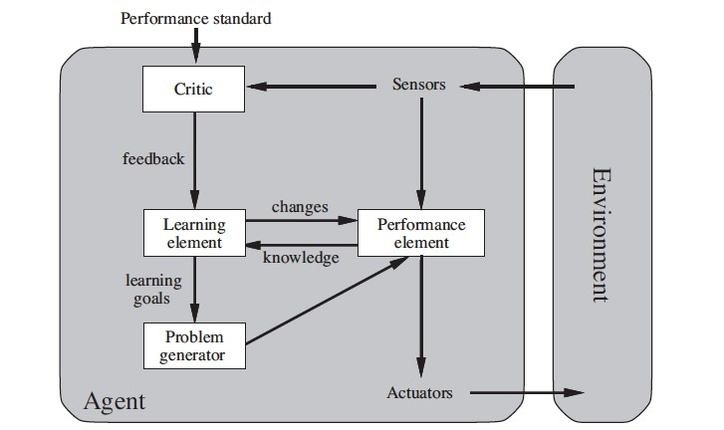

Slide 50
Continue…
The performance element is considered to be the entire agent: it takes in percepts and decides on actions.
The learning element uses feedback from the critic on how the agent is doing and determines, how the performance element should be modified to do better in the future.
Problem generator is responsible for suggesting actions that will lead to new and informative experiences.

Slide 51
SCENARIO Taxi
The taxi goes out on the road and drives, using this performance element. The critic observes the world and passes information along to the learning element.
For example, after the taxi makes a quick left turn across three lanes of traffic, the critic observes the shocking language used by other drivers.
From this experience, the learning element is able to formulate a rule saying this was a bad action, and the performance element is modified by installation of the new rule.

Slide 52
Continue..
The problem generator might identify certain areas of behavior in need of improvement and suggest experiments, such as trying out the brakes on different road surfaces under different conditions.

Slide 53
References
Stuart Russell and Peter Norvig, “Artificial Intelligence”, 2nd edition, Pearson Education, 2003.
NPTEL
Google

